Slide 1
Chapter 9
9-3 Angles of Elevation and Depression

Slide 2
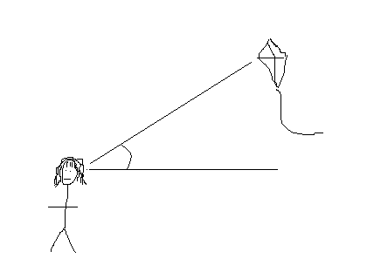
Angle of Elevation
The angle formed by the horizontal and the line of sight to a point above horizontal

Slide 3
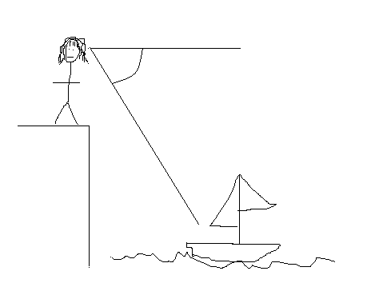
Angle of Depression
The angle formed by the horizontal and the line of sight to a point below horizontal

Slide 4
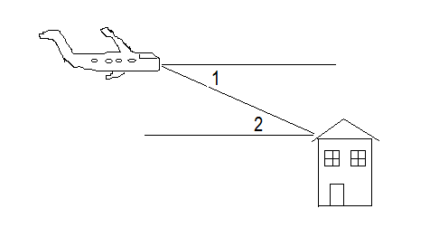
Example #1
Describe 1 and 2.

Slide 5
Example #2
You sight a rock climber on a cliff at a 32° angle of elevation. The horizontal ground distance to the cliff is 1000 ft. Find the line of sight distance to the rock climber.

Slide 6
Example #3
A surveyor stands 200 ft from a building to measure its height with a 5 ft tall theodolite. The angle of elevation to the top of the building is 35°. How tall is the building?

Slide 7
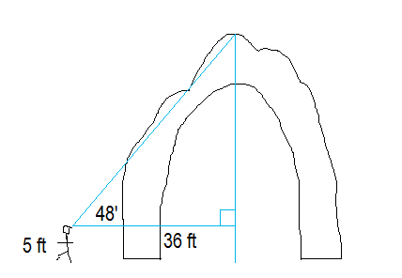
Example #4
Find the height of the arch.

Slide 8
Example #5
To approach the airport, the pilot must begin a 3° descent starting from an altitude of 2714 ft. The airport altitude is 1007 ft. How many miles from the runway is the airplane at the start of this approach?

Slide 9
Example #6
An airplane pilot sights a life raft at a 26° angle of depression. The airplane’s altitude is 3 km. What is the airplane’s surface distance d from the raft?

Slide 10
Example #7
An airplane flying 3500 ft above ground begins a 2° descent to land at an airport. How many miles from the airport is the airplane when it starts its descent?

Slide 11
Example #8
Two buildings are 30 ft apart. The angle of elevation from the top of one to the top of the other is 19°. What is their difference in height?

Slide 12
My Homework is…
Review—next class (Wednesday)
Right Triangle Trig Test—Friday!

